Slide 1
Business Immigration Under Trump: What’s Yet to Come
Moderator:
Josiah Curtis
Panelists:
Philip Curtis
Scott FitzGerald

Slide 2
Buy American Hire American
Key Goal: Protect the economic interests of U.S. workers
Directs agencies to propose changes to H-1B program to ensure that the “most skilled or highest paid” get visas
More public disclosure of H-1B/L-1 usage

Slide 3
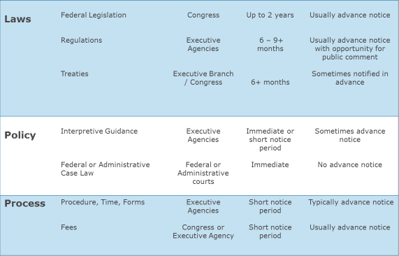
Vehicles for Change
Legislation? (touch on stuff here)
Regulation
Interpretation (2017 trends after)
Make sure to flag questions in writing only

Slide 4
Major 2017 Agency Trends
Greater scrutiny of H-1B petitions
Focus on entry level positions
Consular officer scrutiny
End of deference to prior approvals
Increased enforcement efforts
Introduction of mandatory adjustment interviews

Slide 5
Strategies to Address Increase in USCIS Denials
Level 1 RFEs
Matter of B-C, Inc.
Matter of G-J-S-USA, Inc.
To appeal or refile?
Utilization of blanket vs. filing L-1 petitions with USCIS

Slide 6
Major 2018 Regulatory Priorities
H-4 EADs
STEM Extensions
Reallocation of H-1B Lottery Numbers

Slide 7
Dealing with the Noise
Anxious clients
Uncertainty in adjudications
Increased email and call volumes
Opportunities for our business

Slide 8
Questions and Answers
Please remember to complete evaluation:
https://www.surveymonkey.com/r/2X5WK2Q

