Slide 1
Options After Denial: How to Help Your Client Win in 2020
Moderator:
Josiah Curtis, AILA DOL Committee
Panelists:
Cyrus Mehta, AILA Administrative Litigation Task Force
Leslie Dellon, AIC Staff Attorney, Business Immigration

Slide 2
Adjudications Trends
The belt is tightening, but how specifically?
H-1B
L-1A and L-1B
PERM-based I-140s

Slide 3
So you got a denial…
What do you do now?
Refile?
Request review?
Rush to the AAO?
Run to Federal Court?

Slide 4
Filing the I-290B
What is your goal?
Appeal/Reopen/Reconsider?
Improving the record?
Who can file?

Slide 5
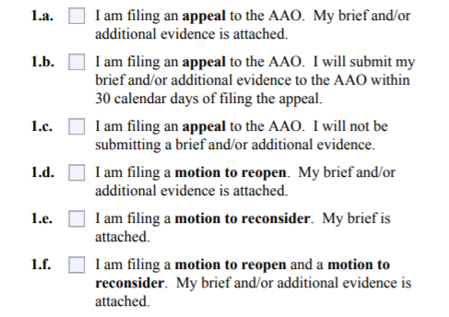
I-290B

Slide 6
Federal Court Litigation
Do we have a duty to discuss it?
Talking to corporate clients
Ethical issues (fees, time tracking)

Slide 7
Questions and Answers
Please remember to complete evaluation:
https://www.surveymonkey.com/r/AILA2020

